Slide 1


Project Apex
Investment Brief
kelpglobal.com

Slide 2













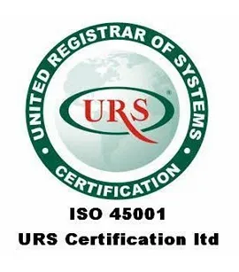




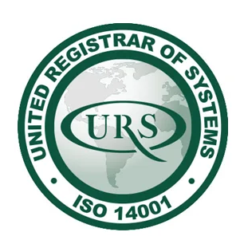
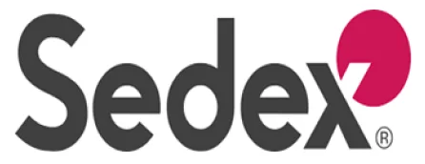

Business Overview
Business Overview:
Key Select Customers
Gamma at a glance
Established in 2001, Apex is a leading manufacturer of natural hydrocolloids and stabilizers, specializing in high-viscosity agents derived from Guar, Cassia, and Tamarind seeds.
2 state-of-the-art processing units in Western and Central India with a combined processing capacity of ~18,000 MTPA and a new specialized derivative plant under construction (expected live in FY26).
Robust export-oriented model with established distribution hubs in the Netherlands, USA, and Singapore to serve Western markets
sticky vendor relationships with global FMCG giants and Oil & Gas majors, ensuring consistent offtake.
Led by second-generation technocrats with deep expertise in polymer chemistry and backed by a reputed family office.
2 Facilities
Located near raw material belts + 1 upcoming
55+ Grades
Customized viscosity & hydration profiles
R&D Offerings
In-house applications lab for food texture analysis
…and others
Growth led through its growing product portfolio and offering solutions to diverse sectors
Certifications
Product Portfolio
Food Grade Guar Gum
Industrial Grade Thickeners
Applications
Bakery
Cosmetics
Mining
Cassia Gum Powder
Tamarind Kernel Powder
Fast Hydration Derivatives
Purified Splits
Textile
Oil & Gas
Pet Food
Cationic Conditioner
Blended Stabilizers
Strictly Private & Confidential – Prepared by Kelp M&A Team

Slide 3
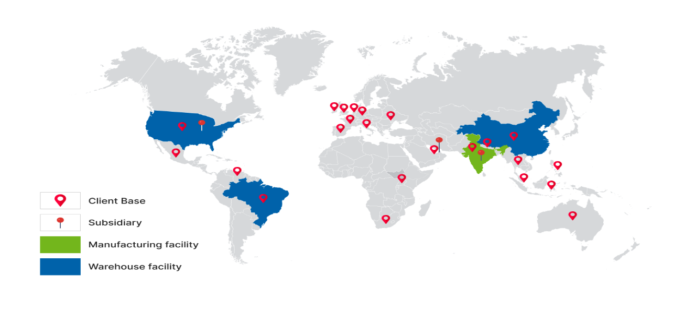
Key Financial Metrics and Growth Story
Key Financial Metrics (FY24)
Expansion in margins driven by shift towards pharma-grade and cosmetic-grade derivatives which command 30% higher pricing than standard industrial gums.
Upcoming Facility
~19.5%
EBITDA Margin
32.4%
RoCE
21.0%
RoE
Zero Debt
(last 3 years)
Currently deploying Capex of ~USD 14mn (internally accrued) to set up a dedicated Derivatization Plant.
This adds 8,000 MT of specialized capacity targeting the Personal Care & Pharma sectors.
Expected to generate incremental revenue of ~USD 30mn with superior EBITDA margins of 22%+.
Focus on chemically modified gums (Hydroxypropyl Guar) which have high entry barriers
Company has launched a "Stabilizer Solutions" division, offering pre-mixed blends to food clients, increasing customer stickiness and wallet share
18% CAGR(5Y)
Contract farming initiatives with 5,000+ farmers in Rajasthan ensure raw material traceability and price stability against market fluctuations.
Global Presence
Assumptions:
Revenue assumed to grow at a constant 18% CAGR (FY26E-28E)
Additional Revenues (FY26 onwards) stemming from materialization of planned capex of $14mn
EBITDA and PAT margins assumed to improve slightly due to product mix shift towards derivatives.
Strictly Private & Confidential – Prepared by Kelp M&A Team

Slide 4






Investment Highlights
Leading global player in natural hydrocolloids with proprietary processing tech - Ranked among the top 5 exporters of cassia gum globally; offering 50+ customized mesh sizes.
Catering to recession-resistant industries like Processed Food and Pharma - Deep integration with clients' R&D teams has resulted in a 90% client retention rate over the last decade.
Strategically located manufacturing in the heart of the "Guar Belt" (Rajasthan/Gujarat) - Minimal logistics cost for raw material procurement; fully automated pulverizing and sterilization units.
Established footprint in high-compliance markets (USA, EU) - ~70% of revenue derived from exports; fully REACH compliant for European customers.
Superior financial profile with industry-leading return ratios - Delivered 18% Revenue CAGR (FY20-24), projected to cross USD 130 Mn turnover by FY28 with sustainable EBITDA margins of ~20%.
Strictly Private & Confidential – Prepared by Kelp M&A Team

Slide 5
Important Notice & Disclaimer
Strictly Private & Confidential. This presentation is prepared by Kelp Global exclusively for the intended recipient and may not be reproduced or distributed without prior written consent. This document is for informational purposes only and does not constitute an offer to sell or a solicitation of an offer to buy any securities. While all information is obtained from sources believed to be reliable, Kelp Global makes no representation or warranty regarding its accuracy or completeness and accepts no liability for any loss arising from its use. This presentation contains forward-looking statements and financial projections (e.g., FY26–FY28E) based on current assumptions; actual results may vary materially.
Strictly Private & Confidential – Prepared by Kelp M&A Team

